Slide 1

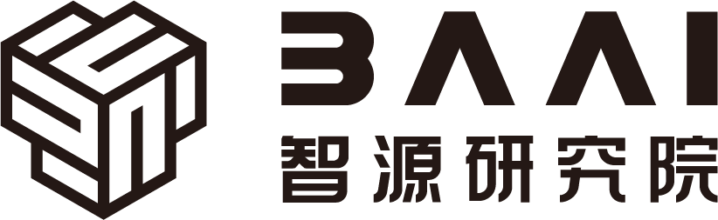

Hardware and Software Fundamentals of
Intelligent Computing
Systems

Slide 2
Lecture 03: Deep Learning Framework Call Chain Analysis

Slide 3
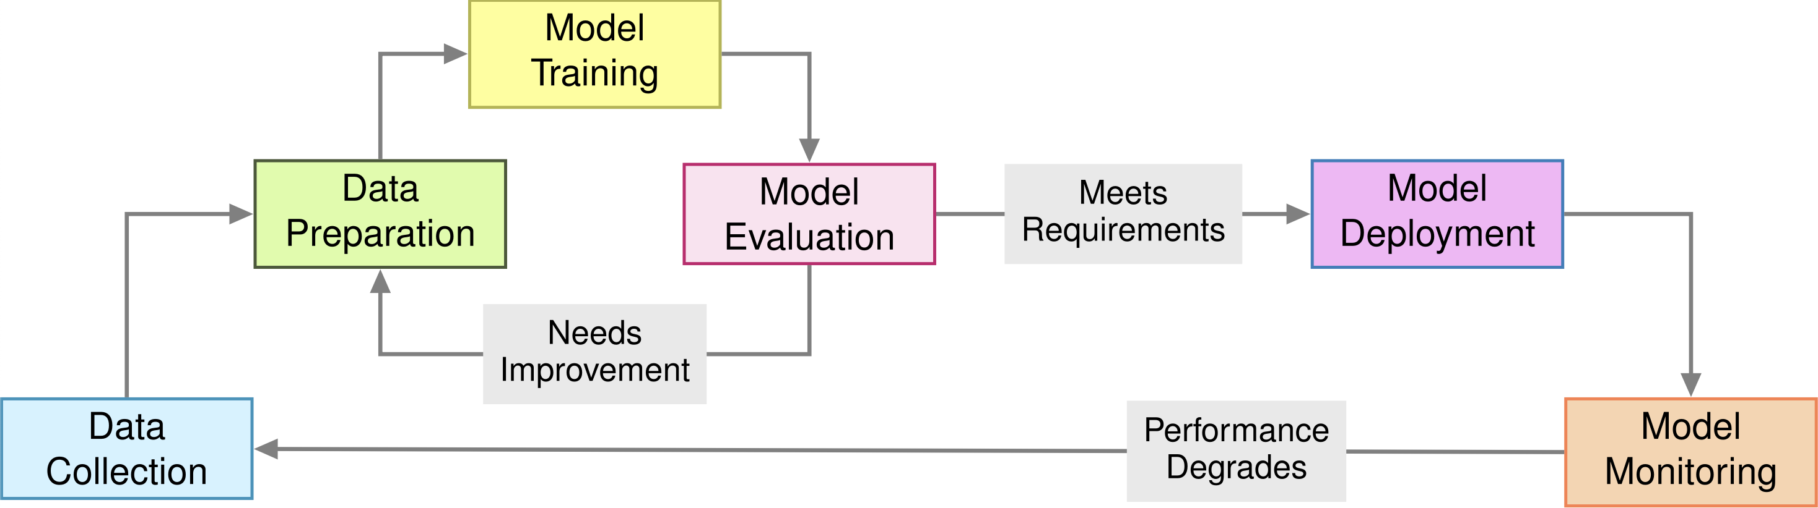
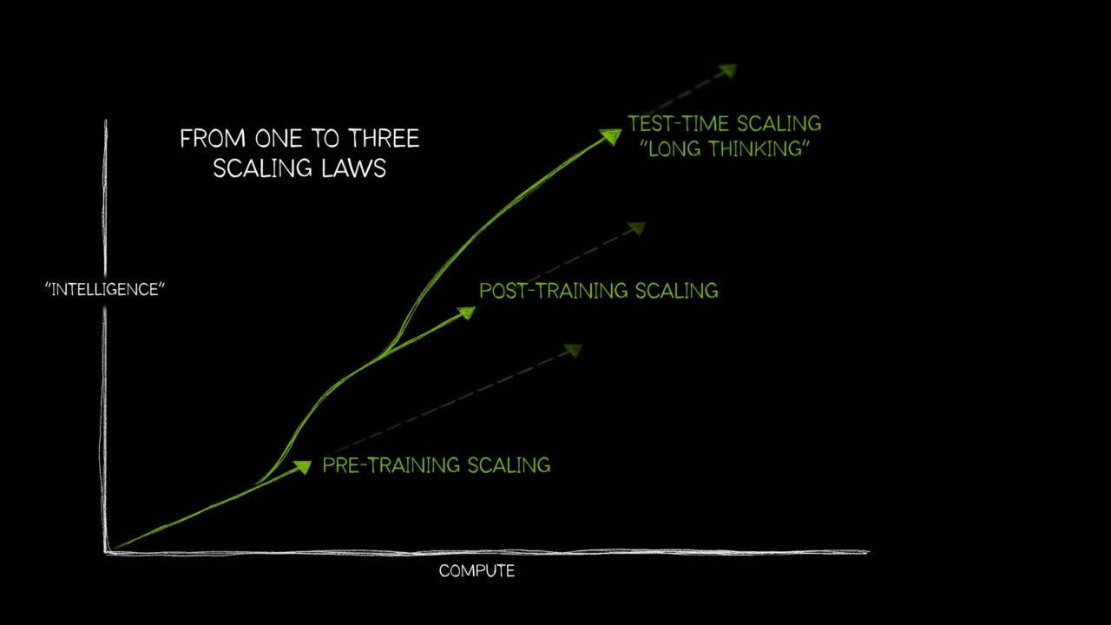
ML System Lifecycle & Three Scaling Laws
pre-train
post-train
serve
develop

Slide 4
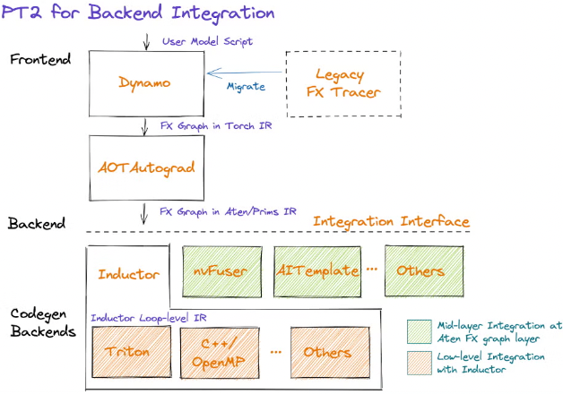
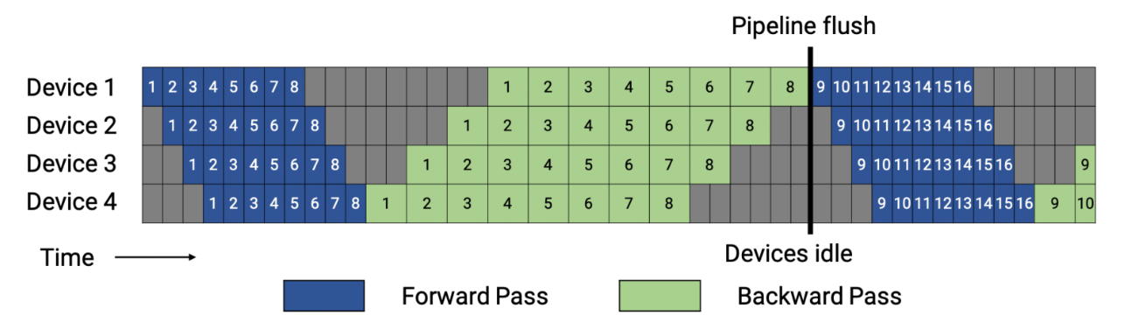
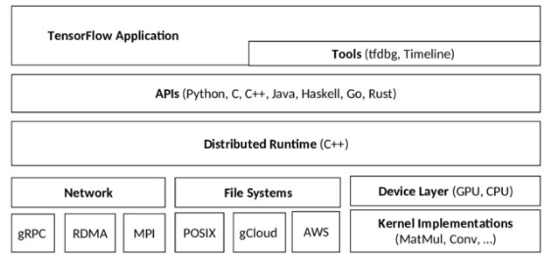
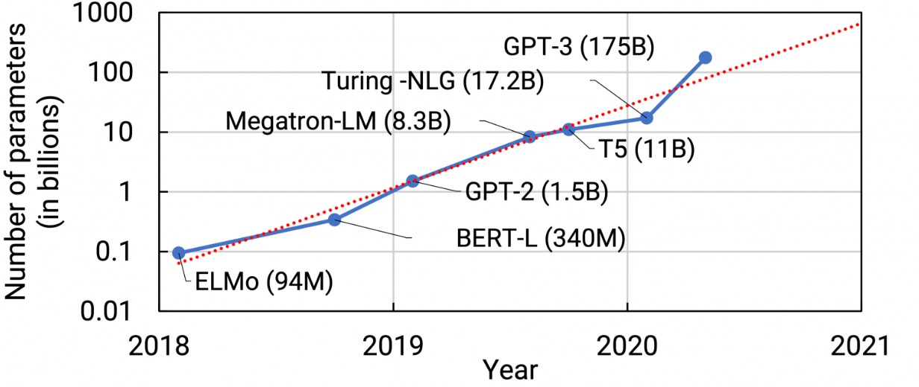
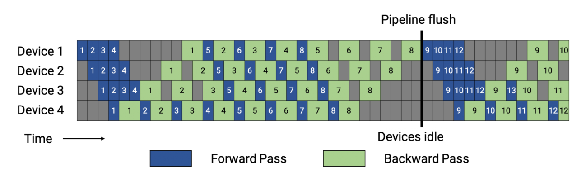
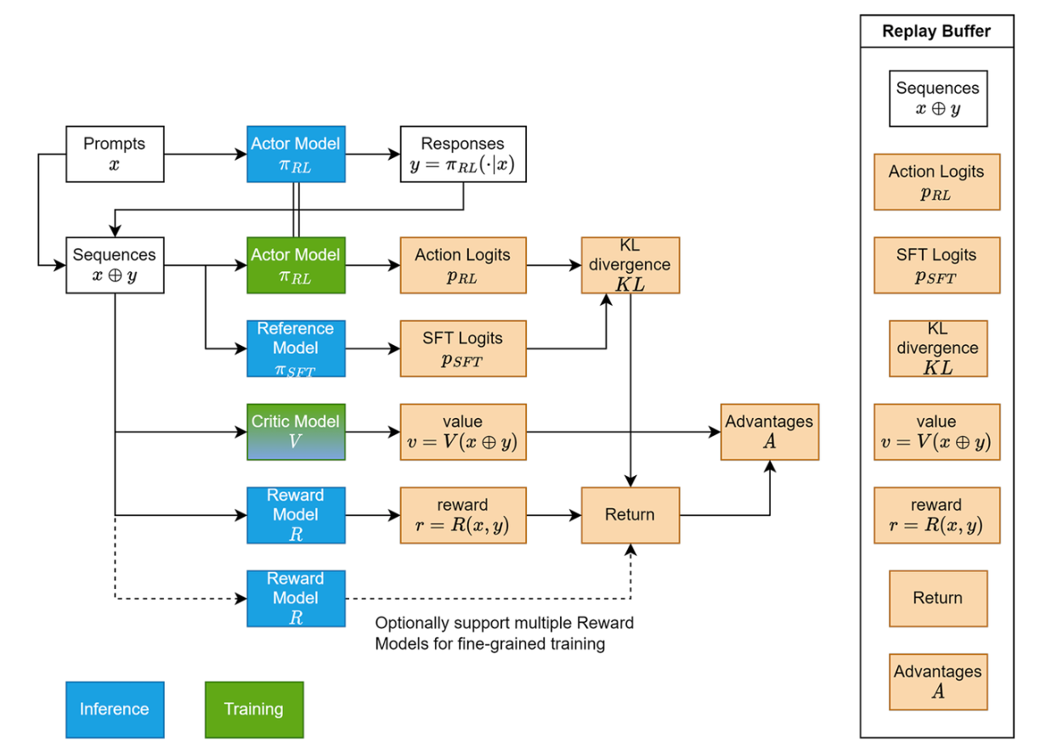
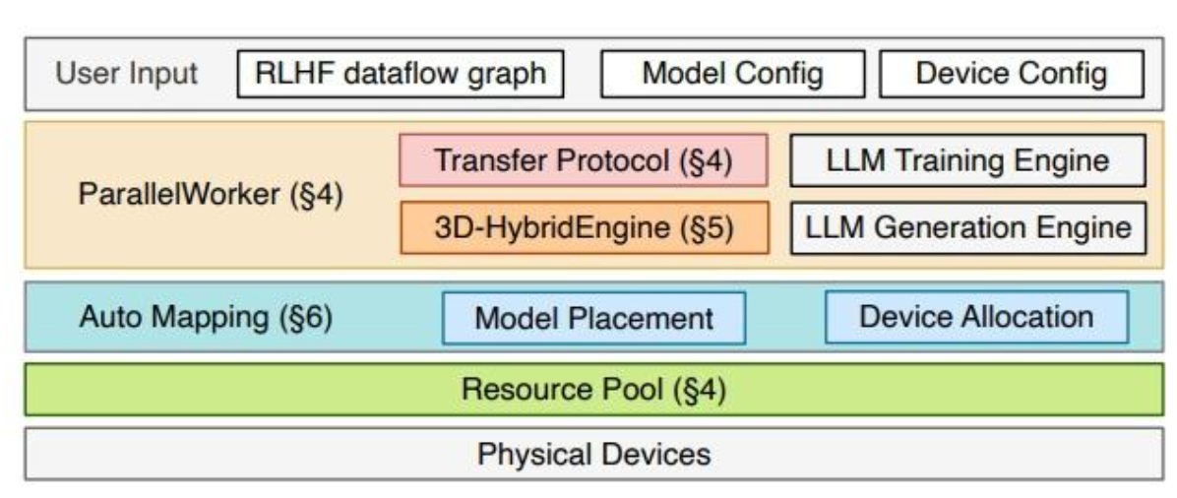
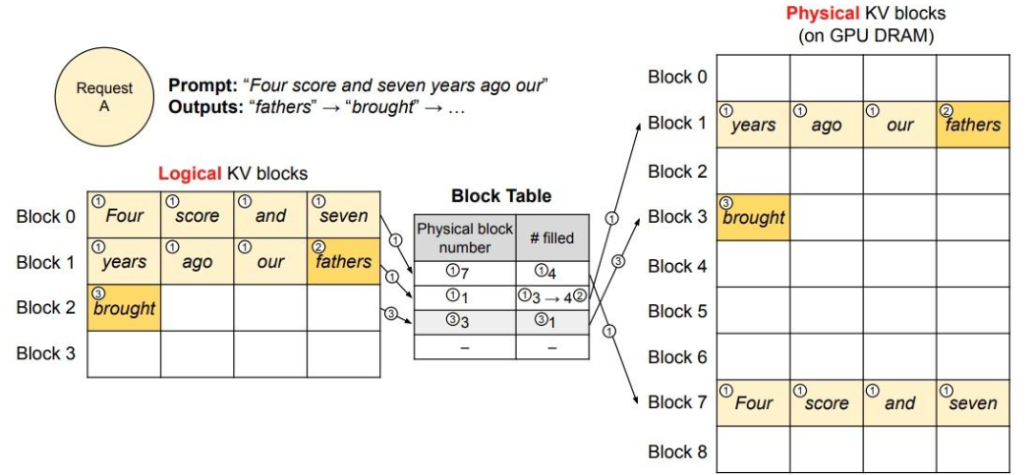
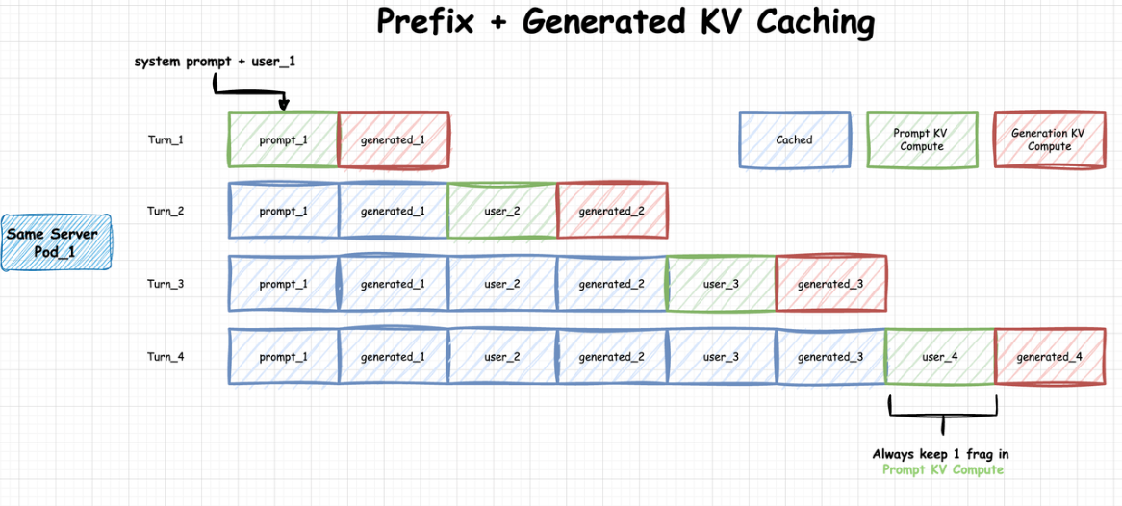
Overview of LLM Software Framework
Basics
Pre-train
PyTorch & Tensorflow
DSL&API, Graph, AutoDiff, Compiler, CodeGen
Megatron-LM & Accelerate
Parallelism Settings, FP/BP Optimization, Redundancy
Serve
Post-train
vLLM & SGLang
Paged Attention, Prefix Caching, Speculative Decoding
OpenRLHF & veRL
Controller & Dataflow Opt, Efficiency & Flexibility
Notes:
Basic ML Framework: PyTorch & Tensorflow.
Efficient LLM Training Framework: DeepSpeed, Megatron-LLM, Accelerate
Efficient LLM Inference Framework: vLLM, SGLang, llama.cpp
Flexible Post Training Framework: verl

Slide 5
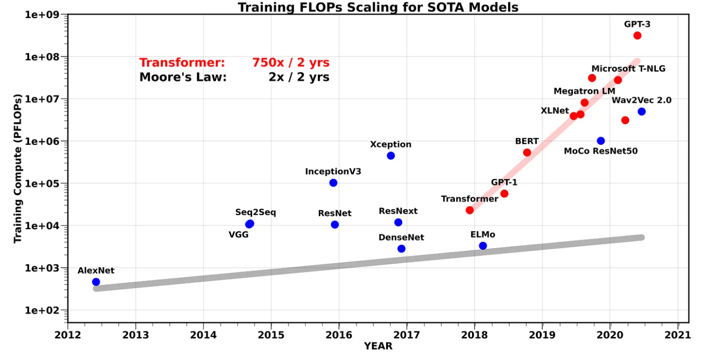
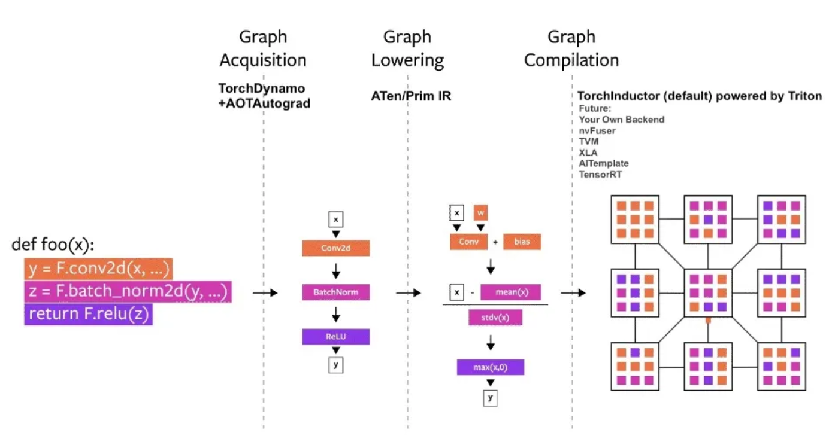
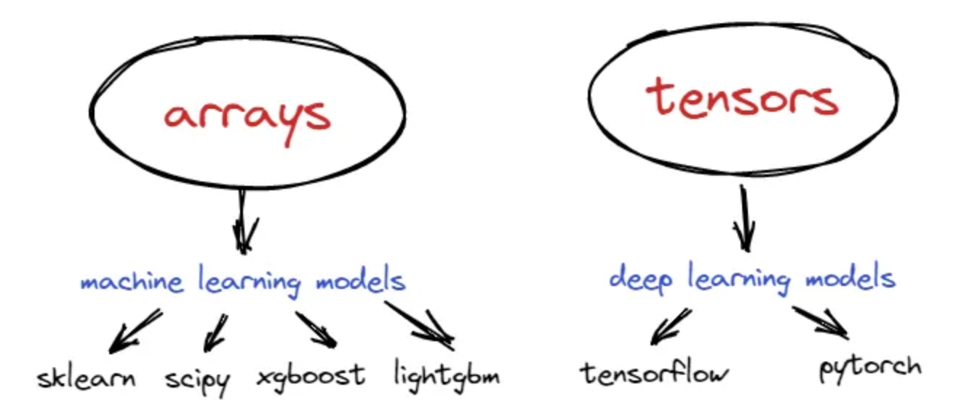
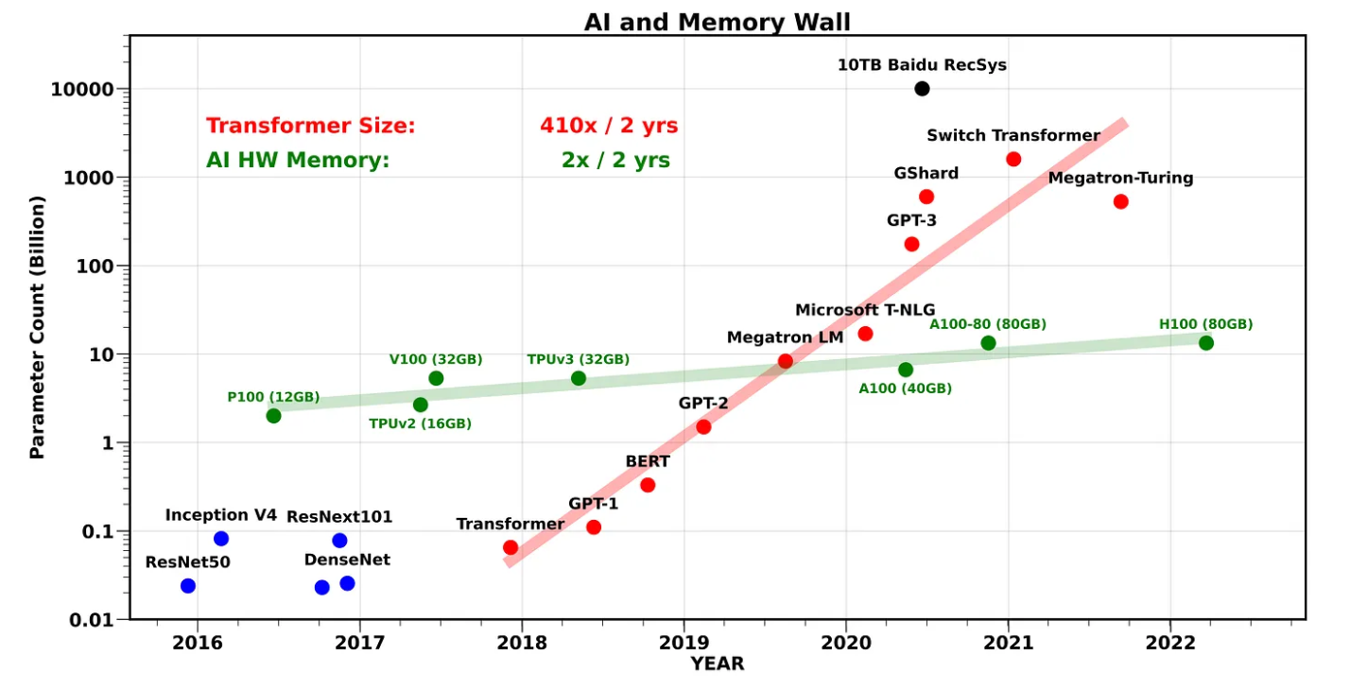

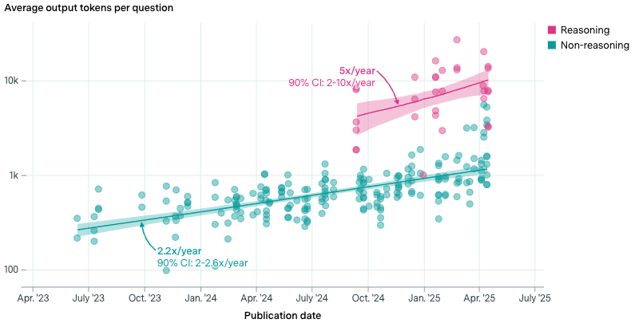
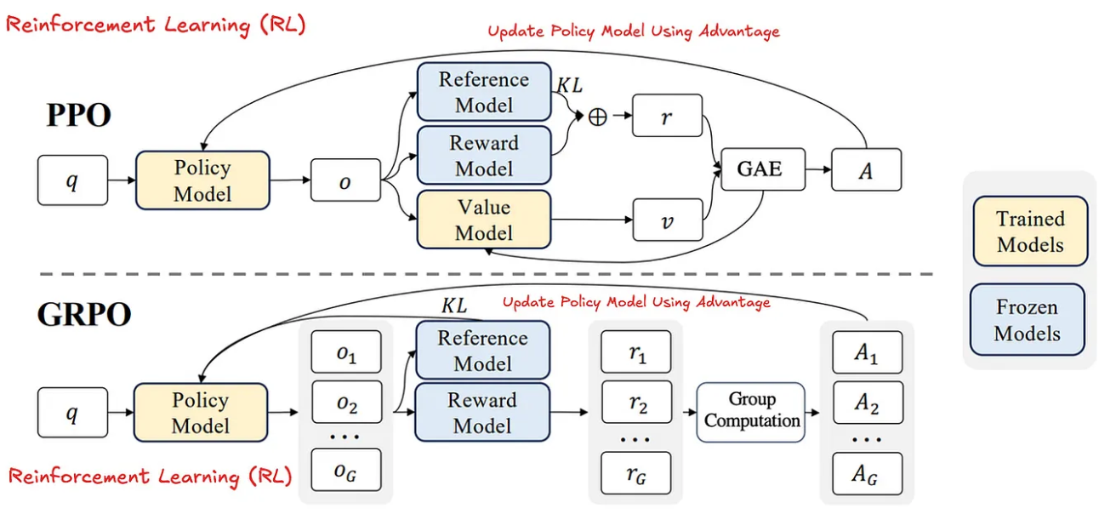
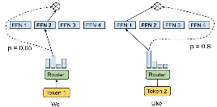
Key Concepts of LLM Software Framework (1/2)
Basics
System
Features: Automation, Abstraction, Backend Portability
Programming Model: Eager Execution v.s. Static Graph
Computation, Memory, and Communication Wall
Algo.
Runtime: Dynamicity at the inference time.
Post-training: DPO, PPO, GRPO, and etc.
Notes:
Basic ML Framework: PyTorch & Tensorflow.
Efficient LLM Training Framework: DeepSpeed, Megatron-LLM, Accelerate
Efficient LLM Inference Framework: vLLM, SGLang, llama.cpp
Flexible Post Training Framework: verl

Slide 6
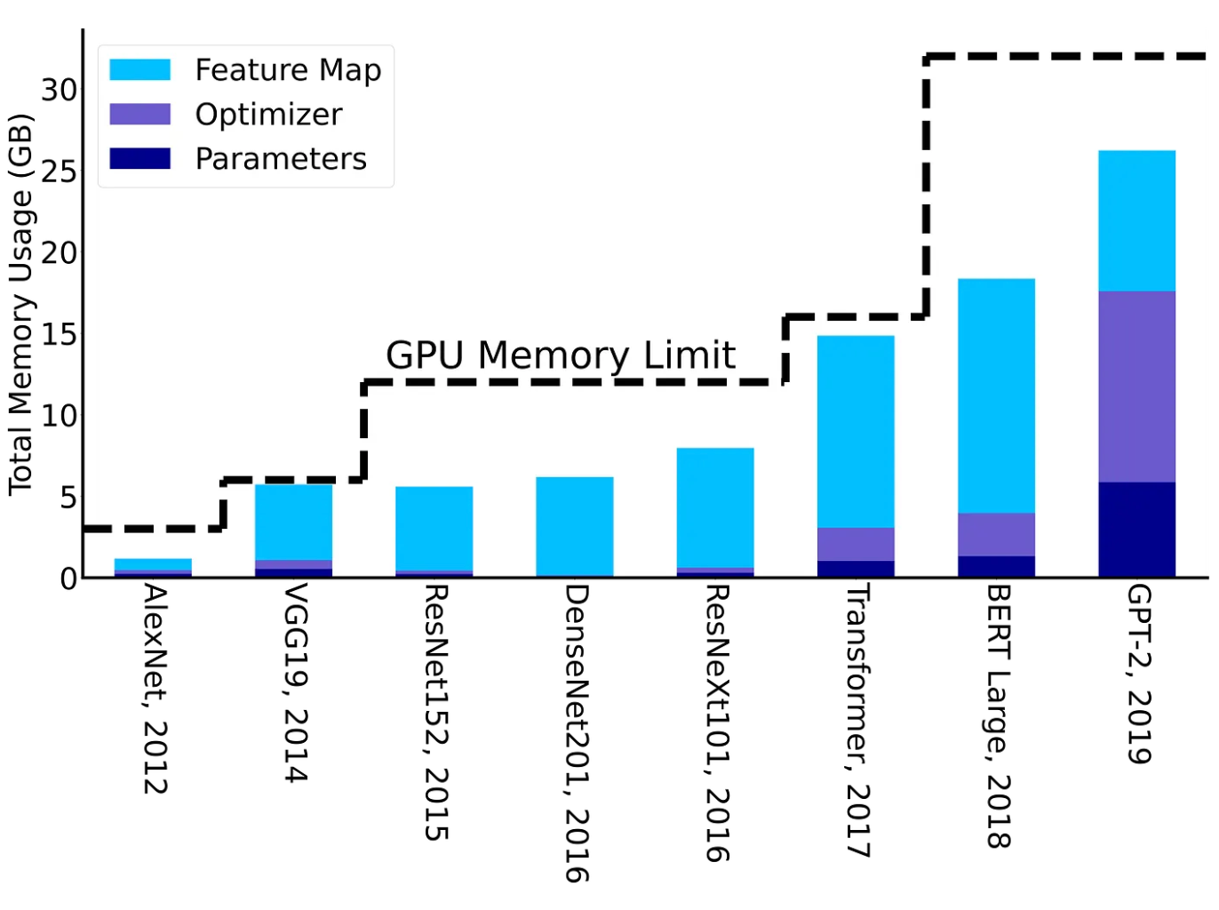
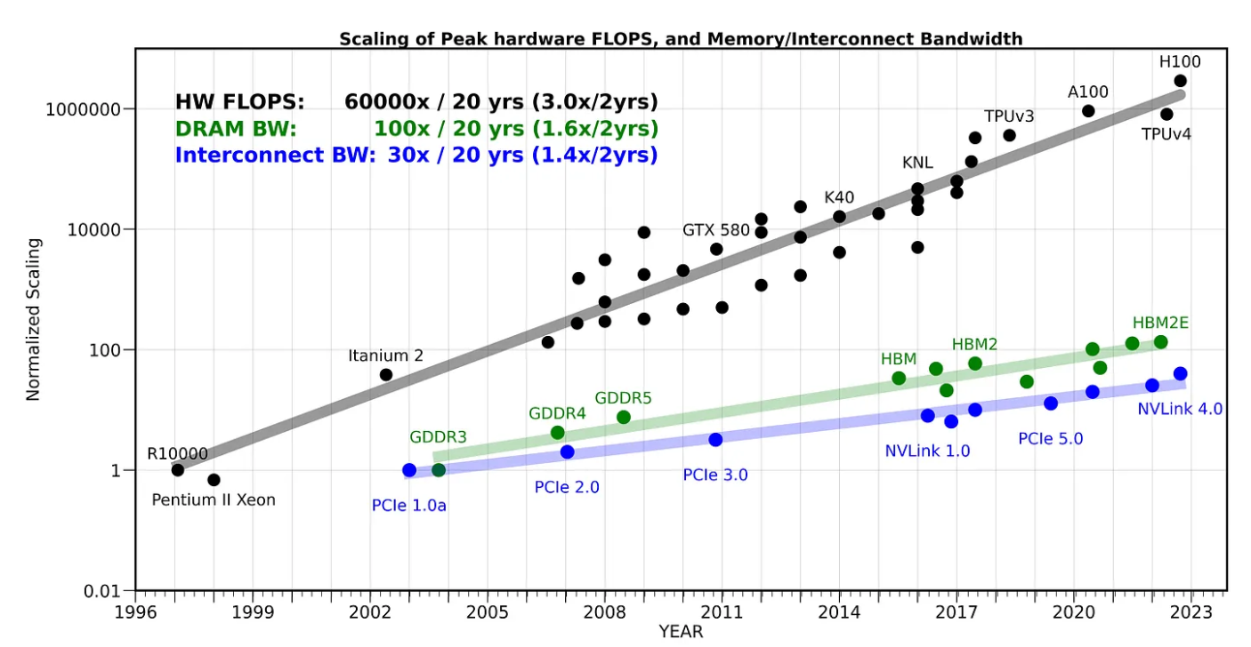
Key Concepts of LLM Software Framework (2/2)
Basics
System
Features: Automation, Abstraction, Backend Portability
Programming Model: Eager Execution v.s. Static Graph
Computation, Memory, and Communication Wall
Algo.
Runtime: Dynamicity at the inference time.
Post-training: DPO, PPO, GRPO, and etc.
Notes:
Basic ML Framework: PyTorch & Tensorflow.
Efficient LLM Training Framework: DeepSpeed, Megatron-LLM, Accelerate
Efficient LLM Inference Framework: vLLM, SGLang, llama.cpp
Flexible Post Training Framework: verl

Slide 7
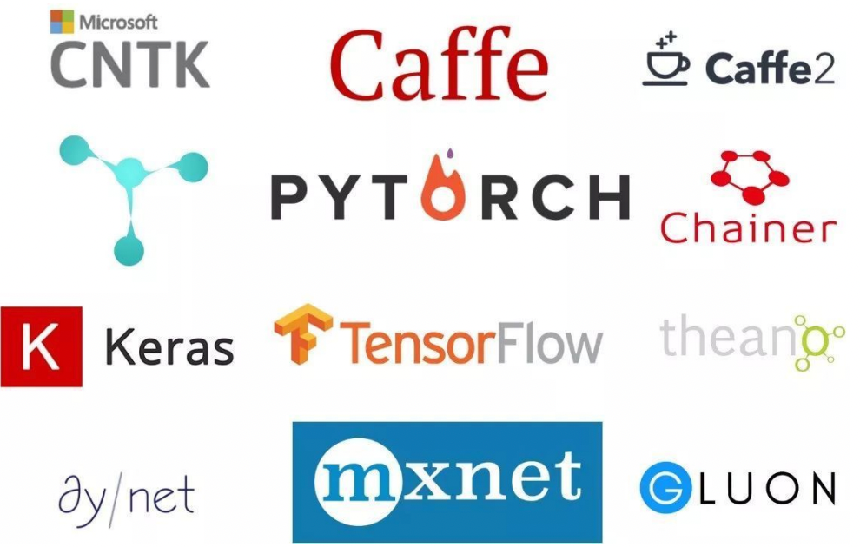
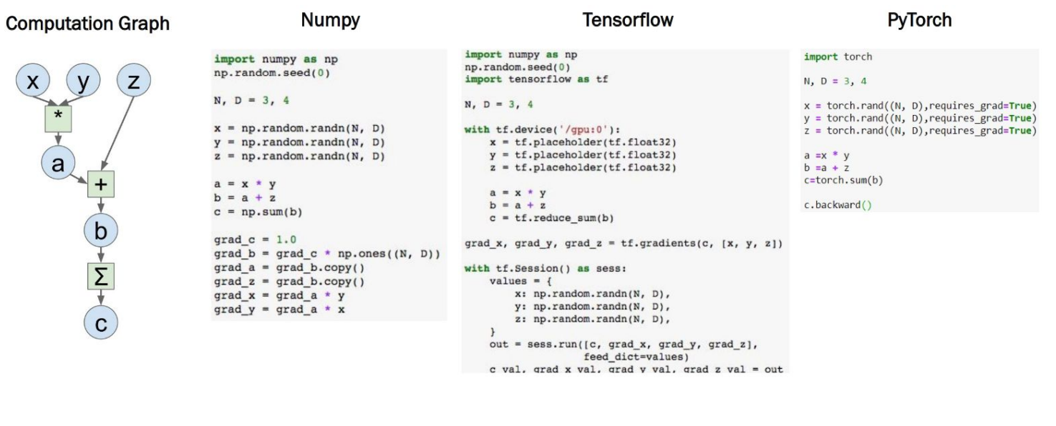
Programming: PyTorch
PyTorch: The (most) popular open-source ML library.
  Tensor definition; GPU-enabled computation; Automatic Differentiation; Compiler Support.
Other ML Frameworks
Numpy vs TensorFlow vs PyTorch

Slide 8
Programming: PyTorch – Tensors
Tensors
  N-dims array in PyTorch, which is similar with NumPy’s ndarrays.
  But torch.Tensor has gradient support and device flag.
Examples: Gradient
  t = torch.randn(1)
  t.requires_grad_()
  or t = torch.randn(1, requires_grad=True)
  Access the value: t.data
  Access the gradient: t.grad
Notes:
https://sites.cc.gatech.edu/classes/AY2021/cs7650_fall/slides/Introduction_to_PyTorch.pdf

Slide 9
Programming: PyTorch – Tensors
Tensors
  N-dims array in PyTorch, which is similar with NumPy’s ndarrays.
  But torch.Tensor has gradient support and device flag.
Examples: Hetero-device Support
  t = torch.randn(1)
  t.to("gpu:1")
  torch.cuda.is_available()
  torch-npu (by Huawei)
  t.to("npu:0")
  torch.npu.is_available()
Distributed Support
DTensor & DeviceMesh
Notes:
https://docs.pytorch.org/tutorials/beginner/dist_overview.html

Slide 10
Programming: PyTorch – Autograd
Autograd: Automatic Differentiation Package
  No need to worry about partial differentiation, chain rule etc. => backward()
  Gradients are accumulated for each step => zero-out gradient after update grad_zero()
Examples: Hetero-device Support
  x = torch.tensor(1., requires_grad = True)
  w = torch.tensor(2., requires_grad = True)
  b = torch.tensor(3., requires_grad = True)
  y = w * x + b # y = 2 * x + 3
  y.backward()
  print(x.grad, w.grad, b.grad) # 2, 1, 1
Notes:
https://sites.cc.gatech.edu/classes/AY2021/cs7650_fall/slides/Introduction_to_PyTorch.pdf

Slide 11
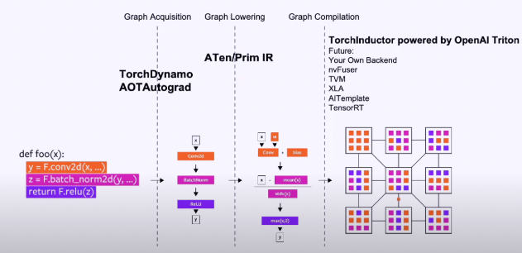
Programming: PyTorch – Inside (1/5)
Enabling a training or inference task is simple. But how about the performance?
  At the beginning, one of the design principles of PyTorch – Easy to use > Performance.
  With the increase of hardware computing power,
  performance, portability, scalability and become more and more important.
So, what is the advanced internal workflow of PyTorch (2.0)?
  How can we accelerate?
  Compilation Optimization
  Graph capturing (acquisition)
  Graph lowering
  Graph compilation
The backend of PyTorch 2.0
Notes:
https://sites.cc.gatech.edu/classes/AY2021/cs7650_fall/slides/Introduction_to_PyTorch.pdf
https://dl.acm.org/doi/pdf/10.1145/3620665.3640366

Slide 12
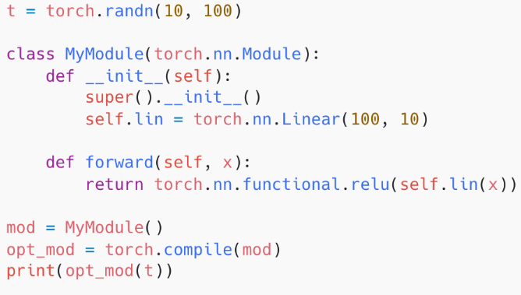
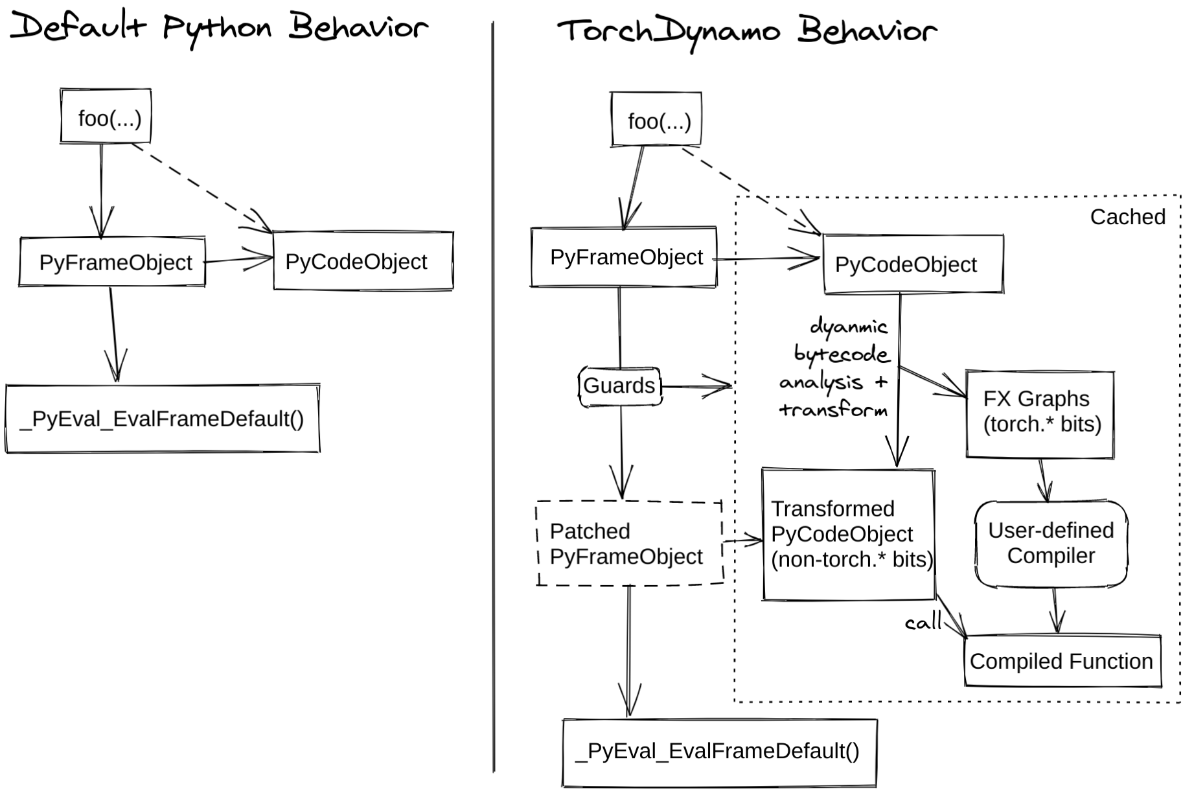
Programming: PyTorch – Inside (2/5)
Unified Entrance @ PyTorch 2.0: torch.compile()
Torch Dynamo (for FP)
  A JIT compiler for computation graph extraction.
  Before Dynamo, there are several initial tries
    TorchScript, TorchFX, LazyTensor, etc
  Dynamo has more flexible support combining
  with the bytecode and VM.
  Graph break when it meets the unsupported ops.
  Graph re-compilation checking (@ static shape mode).
    Tensor Shape, Stride, Device and etc.
  Dynamo also supports dynamic shapes without re-compilation.
AOTAutograd is for the graph extraction during the BP.
Notes:
https://zhuanlan.zhihu.com/p/630933479
https://chips-compilers-mlsys-22.github.io/assets/slides/PyTorch%20Compilers%20(Compiler%20&%20Chips%20Symposium%202022).pdf

Slide 13
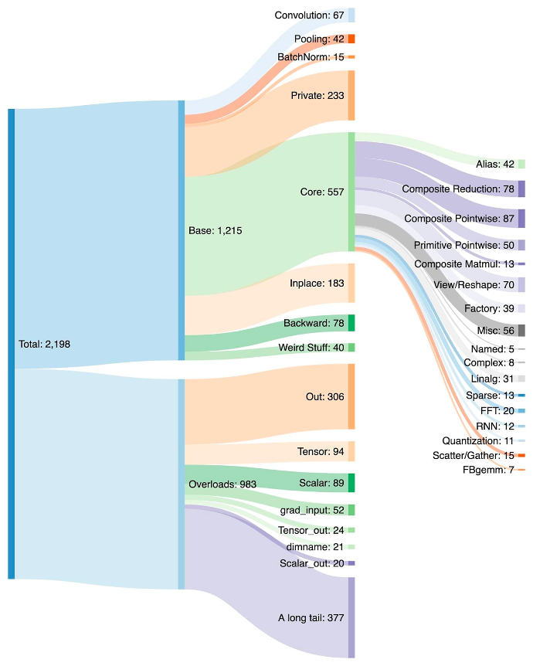
Programming: PyTorch – Inside (3/5)
Unified Entrance @ PyTorch 2.0: torch.compile()
ATen/PrimIR
  # ops in PyTorch: 1200+ (2000+ overload ops)
  # ops in Prim IR: ~250 (fairly low-level)
  # canonical ops in ATen: ~750
Prim IR operators should be fused for better perf.
ATen IR operators
  suited for backends that already integrate at ATen level
  backends that won’t have compilation to recover performance from a lower-level operator set like Prim ops
Notes:
https://docs.pytorch.org/docs/stable/torch.compiler_ir.html
https://pytorch.org/get-started/pytorch-2-x/

Slide 14
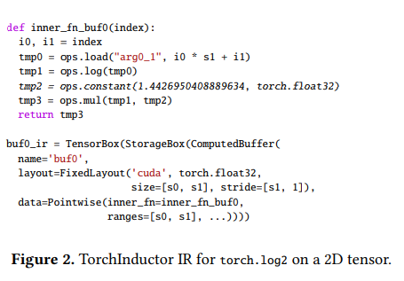
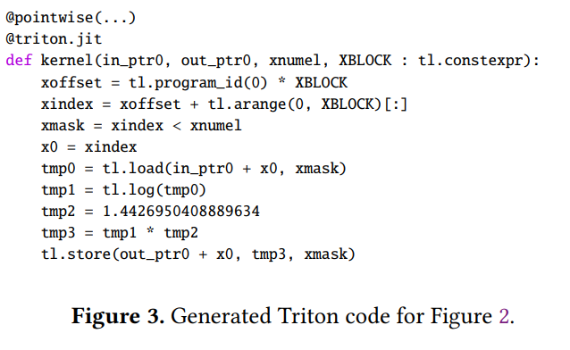
Programming: PyTorch – Inside (4/5)
Unified Entrance @ PyTorch 2.0: torch.compile()
Torch Inductor w/ OpenAI Triton support
  The default compiler backend.
  Python-native & PyTorch-first.
  Loop-level TorchInductor IR has 54 primitive operators.
Define-by-run Concept
  IR uses executable Python code to define the bodies of loops
  Sympy symbols for the dynamic shapes.
Scheduling: mainly for the operator fusions.
CodeGen: Triton, C++, and wrapper.
Notes:
https://dev-discuss.pytorch.org/t/torchinductor-a-pytorch-native-compiler-with-define-by-run-ir-and-symbolic-shapes/747
这里面最重要的理念是define-by-run

Slide 15
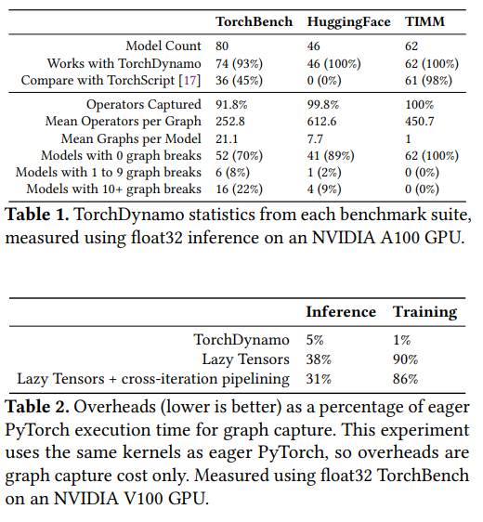
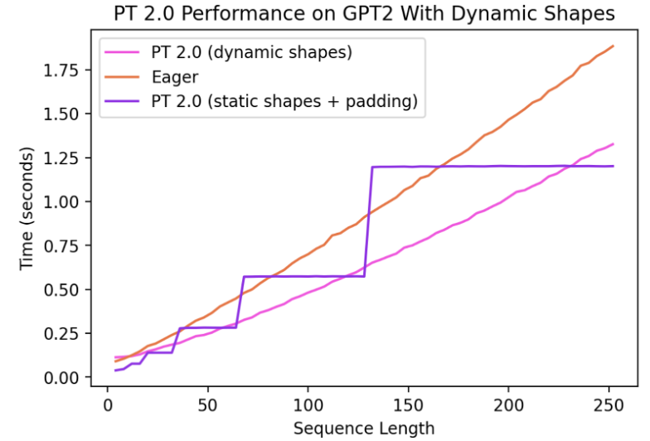
Programming: PyTorch – Inside (5/5)
Evaluations of PyTorch 2.0
  Better performance
  Dynamic shapes
  More model supports
Notes:
https://blog.csdn.net/weixin_38235865/article/details/130085600

Slide 16

The Solution: FlagOS, a Unified AI Software Stack

Slide 17








https://space.bilibili.com/3546791834290849
https://github.com/flagos-ai
https://www.zhihu.com/people/95-22-20-18/posts
https://flagos.io/Home

Slide 18

Thanks for your time！

